Slide 1

CUSTOMER SEGMENTATION AND DEPOSIT DETECTION SYSTEM
Salamah Alawiye

Slide 2
AGENDA
INTRODUCTION
PROBLEM DEFINITION
DATA CLEANING & PROCESSING
KEY INSIGHTS
RECOMMENDATIONS
ANALYSIS

Slide 3
Introduction
Nexus bank is a financial institution dedicated to delivering unparalled banking services to its clients. They offer services that includes term deposits, personal loans and mortgage financing.
However, Nexus bank has conducted campaigns to increase its customer’s deposit but this yielded no results.

Slide 4
PROBLEM DEFINITION
Identify patterns and trends in customers behaviour.
How effective have the campaigns being?
Analyze loan trends and marketing campaign effectiveness
Analysis on optimizing operations and mitigating risks/loan defaults
How to improve customer deposits
Anticipate future customer behaviour and likelihood of customers deposits

Slide 5

DATA CLEANING & PROCESSING

Slide 6
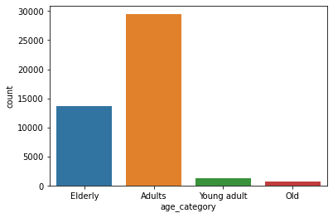
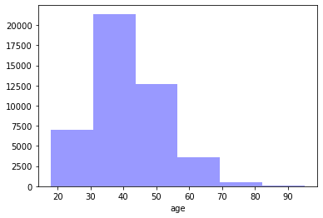
UNIVARIATE ANALYSIS
Age demographic- adults were the most populated in the dataset.
It can be confirmed because those between age 30-40 are the most populated.

Slide 7
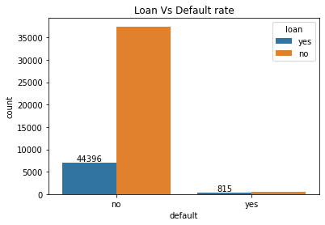
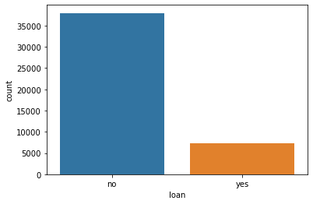
Bivariate analysis
Loan behaviour-it can be seen that over 70% of the population had no acquired loan
However, those that acquired loan in the bank had little default rate which is great.

Slide 8
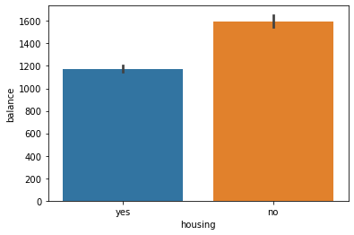
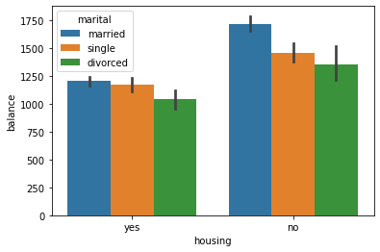
Further analysis
75% of those with housing loan has less account balance while those with no loan had more.
This analysis showed that married customers have more account balance compared to others

Slide 9
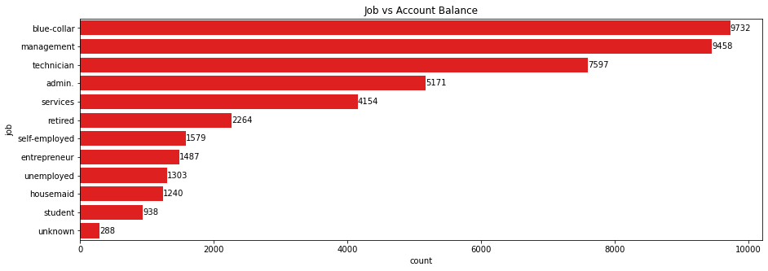
Further analysis

Slide 10
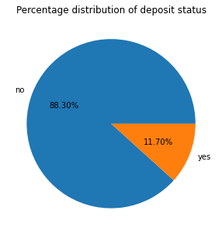
Further analysis
88.3% of customers had no deposit in the bank which is detrimental to a financial institution.

Slide 11
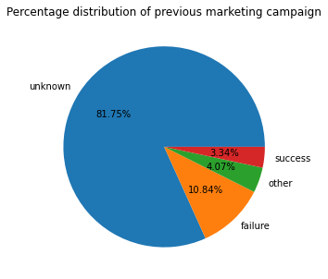
Further analysis
This analysis shows 10.84% of the campaign failed while 3.34% was a success which means that in general previous campaigns weren’t a success

Slide 12
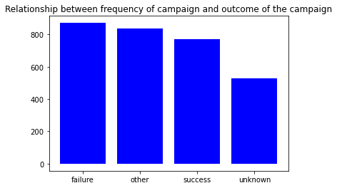
Further analysis
Looking at the period between the period of campaign and the frequency of campaign, it shows that the less frequent a customer is reached out to, the higher the rate of failure and vice-versa.

Slide 13
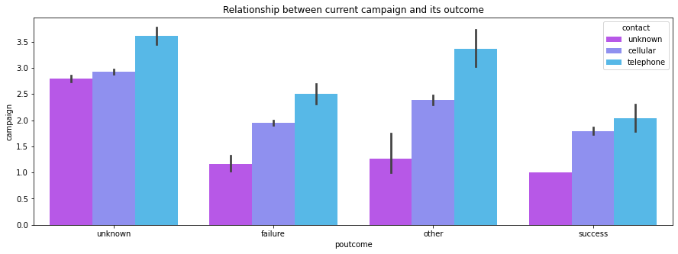
Further analysis
This analysis shows the telephone was the most used mode of communication

Slide 14
KEY INSIGHTS
The previous campaign carried out was a failure
AGE DEMOGRAPHIC
The largest population of customers are the adults
Loan
About 70% of the total population had no loan acquired from the bank
Loan default
The rate of compliance with loan acquisition is high compared to the default rate
Over 88% of customers had no deposits in the bank which is alarming
Campaign
Deposit
1
2
3
4
5

Slide 15
RECOMMENDATIONS
Implementing high interest returns on savings to increase the number of deposits
Having less period between campaigns could be implemented which could increase the success rate
The major means of communication was through the telephone. However, other means to run campaign are available which includes social media adverts, influencer’s adverts, etc
The elderly are the 2nd largest population so building trust within this demographic is key and implementing factors like excellent customer service, different saving schemes like pension management schemes could be implemented.
Looking at job demographic, the least 5 have lesser savings so the incorporation of zero payment when creating accounts, low interest rate on loan collection would greatly entise these population

Slide 16
LIMITATIONS
The dataset had a lot of unknown or other values which could have affected the analysis of the report.

Slide 17
Thank you
Salamah Alawiye
www.linkedin.com/in/salamahalawiye
https://github.com/sallytheanalyst

